Slide 1
Tools and Techniques “Feeding Recommender Systems with Linked Open Data”
Tommaso Di Noia
t.dinoia@poliba.it
Politecnico di Bari ITALY

Slide 2







Recommender Systems
A definition
Recommender Systems (RSs) are software tools and techniques providing suggestions for items to be of use to a user.
[F. Ricci, L. Rokach, B. Shapira, and P. B. Kantor, editors. Recommender Systems Handbook. Springer, 2011.]
Input Data:
A set of users U={u₁, …, u_{M}}
A set of items X={x₁, …, x_{N}}
The rating matrix R=[r_{u,i}]
Problem Definition:
Given user u and target item i
Predict the rating r_{u,i}

Slide 3
The rating matrix
The Matrix
Titanic
I love shopping
Argo
Love Actually
The hangover
Tommaso
5 | 1 | 2 | 4 | 3 | ??
2 | 4 | 5 | 3 | 5 | 2
4 | 3 | 2 | 4 | 1 | 3
3 | 5 | 1 | 5 | 2 | 4
4 | 4 | 5 | 3 | 5 | 2
Enrico
Sean
Natasha
Valentina

Slide 4
The rating matrix (in the real world)
The Matrix
Titanic
I love shopping
Argo
Love Actually
The hangover
Tommaso
5 |  |  | 4 | 3 | ??
2 | 4 | 5 |  | 5
 | 3 |  | 4 |  | 3
3 | 5 |  | 5 | 2
4 | 4 | 5 |  | 5 | 2
Enrico
Sean
Natasha
Valentina

Slide 5

Collaborative Recommender Systems
Collaborative RSs recommend items to a user by identifying other users with a similar profile
Recommender System
User profile
Top-N Recommendations
Item1, 5
Item2, 1
Item5, 4
Item10, 5
….
Item7
Item15
Item11
…
Users
Item1, 4
Item2, 2
Item5, 5
Item10, 3
….
Item1, 4
Item2, 2
Item5, 5
Item10, 3
….
Item1, 4
Item2, 2
Item5, 5
Item10, 3
….
….

Slide 6
Content-based Recommender Systems
CB-RSs recommend items to a user based on their description and on the profile of the user’s interests
Recommender System
User profile
Top-N Recommendations
Item1, 5
Item2, 1
Item5, 4
Item10, 5
….
Item7
Item15
Item11
…
Items
Item2
Item1
….
Item’s descriptions
Item100

Slide 7
Knowledge-based Recommender Systems
KB-RSs recommend items to a user based on their description and domain knowledge encoded in a knowledge base
User profile
Recommender System
Item1, 5
Item2, 1
Item5, 4
Item10, 5
….
Top-N Recommendations
Items
Item7
Item15
Item11
…
Item2
Item1
….
Item’s descriptions
Item100
Knowledge-base

Slide 8
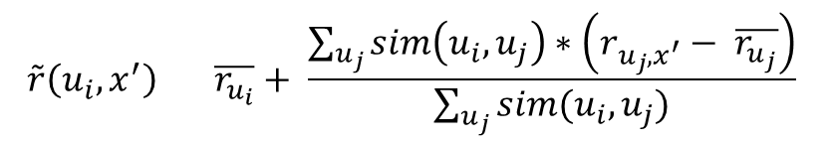
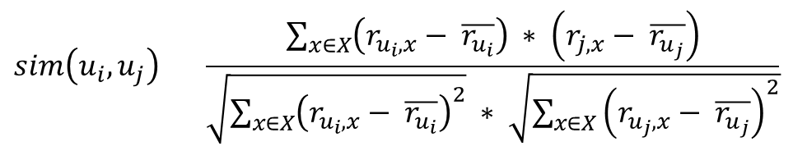

User-based Collaborative Recommendation
$= X$
Pearson’s correlation coefficient
$$sim\left(u_{i},u_{j}\right)= \frac{\sum_{x∈X}{\left(r_{u_{i},x}− \overline{r_{u_{i}}}\right) ∗ \left(r_{j,x}− \overline{r_{u_{j}}}\right)}}{\sqrt{\sum_{x∈X}{{\left(r_{u_{i},x}− \overline{r_{u_{i}}}\right)}^{2}}} ∗ \sqrt{\sum_{x∈X}{{\left(r_{u_{j},x}− \overline{r_{u_{j}}}\right)}^{2}}}}$$
The Matrix
Titanic
I love shopping
Argo
Love Actually
The hangover
Rate prediction
Tommaso
5 | 1 | 2 | 4 | 3 | ??
2 | 4 | 5 | 3 | 5 | 2
4 | 3 | 2 | 4 | 1 | 3
3 | 5 | 1 | 5 | 2 | 4
4 | 4 | 5 | 3 | 5 | 2
Enrico
$$\tilde{r}\left(u_{i},x^{′}\right)= \overline{r_{u_{i}}}+ \frac{\sum_{u_{j}}{sim\left(u_{i}, u_{j}\right)∗\left(r_{u_{j},x^{′}}− \overline{r_{u_{j}}}\right)}}{\sum_{u_{j}}{sim(u_{i}, u_{j})}}$$
Sean
Natasha
Valentina

Slide 9
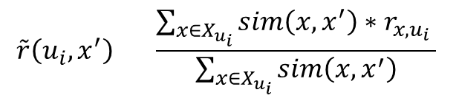
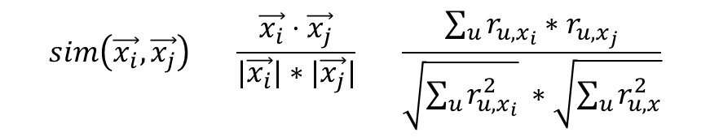

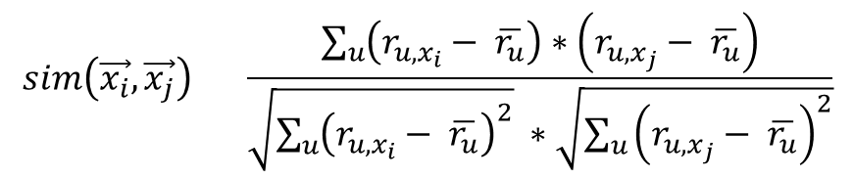
Item-based Collaborative Recommendation
Cosine Similarity
$${= X}_{u_{i}}$$
$$sim\left(\vec{x_{i}},\vec{x_{j}}\right)= \frac{\vec{x_{i}}⋅\vec{x_{j}}}{|\vec{x_{i}}|∗|\vec{x_{j}}|}= \frac{\sum_{u}{r_{u,x_{i}}∗r_{u,x_{j}}}}{\sqrt{\sum_{u}{r_{u,x_{i}}^{2}}} ∗\sqrt{\sum_{u}{r_{u,x}^{2}}}}$$
Adjusted Cosine Similarity
$$sim\left(\vec{x_{i}},\vec{x_{j}}\right)= \frac{\sum_{u}{\left(r_{u,x_{i}}− \overline{r_{u}}\right)∗\left(r_{u,x_{j}}− \overline{r_{u}}\right)}}{\sqrt{\sum_{u}{{\left(r_{u,x_{i}}− \overline{r_{u}}\right)}^{2}}} ∗\sqrt{\sum_{u}{{\left(r_{u,x_{j}}− \overline{r_{u}}\right)}^{2}}}}$$
The Matrix
Titanic
I love shopping
Argo
Love Actually
The hangover
Tommaso
5 | 1 | 2 | 4 | 3 | ??
2 | 4 | 5 | 3 | 5 | 2
4 | 3 | 2 | 4 | 1 | 3
3 | 5 | 1 | 5 | 2 | 4
4 | 4 | 5 | 3 | 5 | 2
Rate prediction
Enrico
Sean
$$\tilde{r}\left(u_{i},x^{′}\right)= \frac{\sum_{x∈X_{u_{i}}}{sim\left(x, x^{′}\right)∗r_{x,u_{i}}} }{\sum_{x∈X_{u_{i}}}{sim\left(x, x^{′}\right)}}$$
Natasha
Valentina

Slide 10
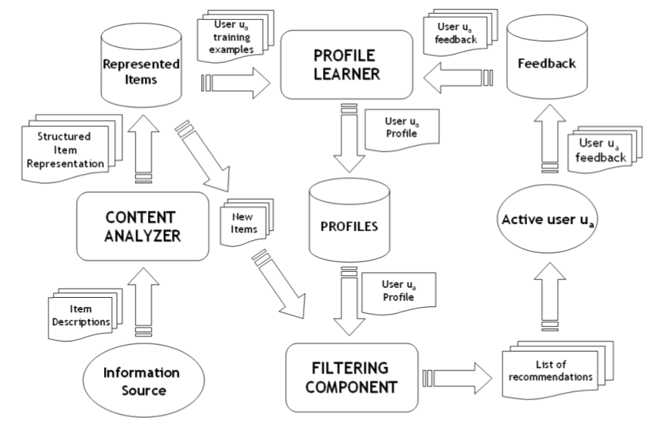
Content-Based Recommender Systems

Slide 11
Content-Based Recommender Systems
Items are described in terms of attributes/features
A finite set of values is associated to each feature
Items representation is a (Boolean) vector

Slide 12

Content-Based Recommender Systems
Compute similarity between items
Jaccard similarity
$$sim\left(\vec{x_{i}},\vec{x_{j}} \right)= \frac{|\vec{x_{i}}∩\vec{x_{j}}|}{|\vec{x_{i}}∪\vec{x_{j}}|}$$

Slide 13

Content-Based Recommender Systems
Compute similarity between items
Cosine similarity
$$sim\left(\vec{x_{i}},\vec{x_{j}} \right)= \frac{\vec{x_{i}}⋅\vec{x_{j}}}{\left|\vec{x_{i}}\right|∗|\vec{x_{j}}|}$$

Slide 14
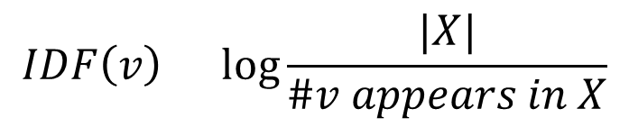

Content-Based Recommender Systems
Compute similarity between items
Cosine similarity and TF-IDF
$$TF\left(v,x\right)=\# v appears in the description of x$$
$$IDF\left(v\right)=\log{\frac{|X|}{\#v appears in X}}$$
$$\vec{x}=(TF\left(v_{1},x\right)∗IDF\left(v_{1}\right), …,TF\left(v_{n},x\right)∗IDF\left(v_{n}\right))$$
$$sim\left(\vec{x_{i}},\vec{x_{j}} \right)= \frac{\vec{x_{i}}⋅\vec{x_{j}}}{\left|\vec{x_{i}}\right|∗|\vec{x_{j}}|}$$

Slide 15
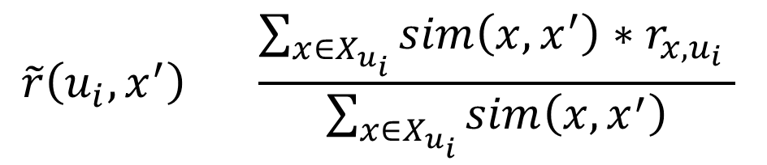
Content-Based Recommender Systems
Rate prediction
$$\tilde{r}\left(u_{i},x^{′}\right)= \frac{\sum_{x∈X_{u_{i}}}{sim\left(x, x^{′}\right)∗r_{x,u_{i}}} }{\sum_{x∈X_{u_{i}}}{sim\left(x, x^{′}\right)}}$$
=

Slide 16
Content-Based Recommender Systems
Nearest neighbors
Given a set of items representing the user profile, select their most similar items which are not in the user profile
Predict the rate only for the N nearest neighbors

Slide 17






Content-Based Recommender Systems
Nearest neighbors with kNN
k = 5
$$x_{i,1}$$
$$x_{i,2}$$
$$x_{i,3}$$
$$x_{i,4}$$
$$x_{i,5}$$
$$x_{i,6}$$

Slide 18
Content-Based Recommender Systems

Slide 19
Main CB RSs Drawback: Limited Content Analysis
No suggestion is available if the analyzed content does not contain enough information to discriminate items the user might like from items the user might not like.*
The quality of CB recommendations are correlated with the quality of the features that are explicitly associated with the items.
Need of domain knowledge!
We need rich descriptions of the items!
(*) P. Lops, M. de Gemmis, G. Semeraro. Content-based Recommender Systems: State of the Art and Trends. In: P. Kantor, F. Ricci, L. Rokach and B. Shapira, editors, Recommender Systems Handbook: A Complete Guide for Research Scientists & Practitioners

Slide 20

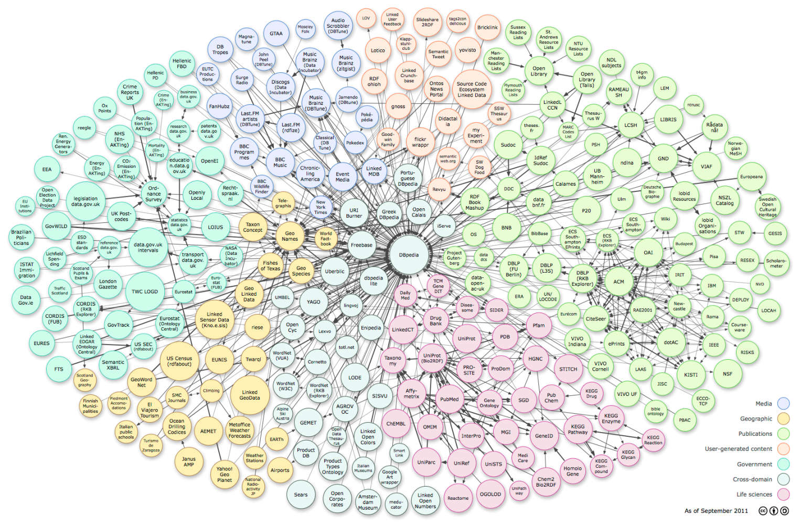
A solution based on Linked Data
Use Linked Data to mitigate the limited content analysis issue
Plenty of structured data available
No Content Analyzer required

Slide 21
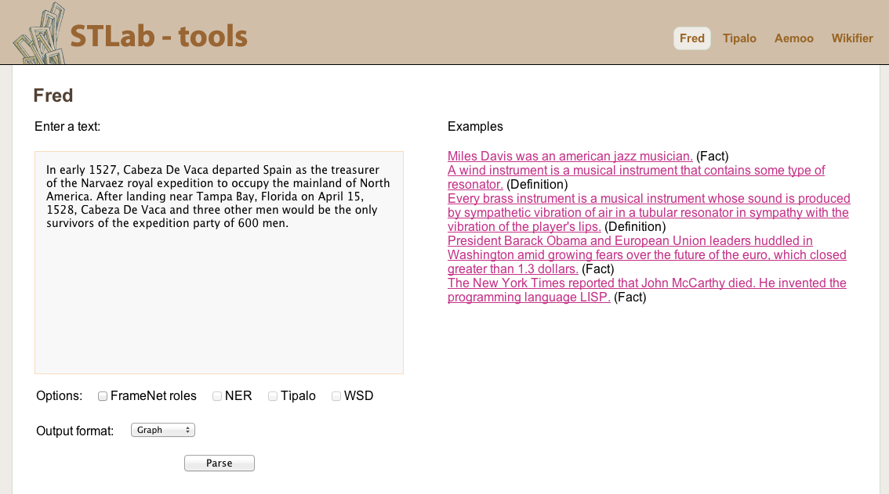
FRED: Transforming Natural Language text to RDF/OWL graphs
input

Slide 22
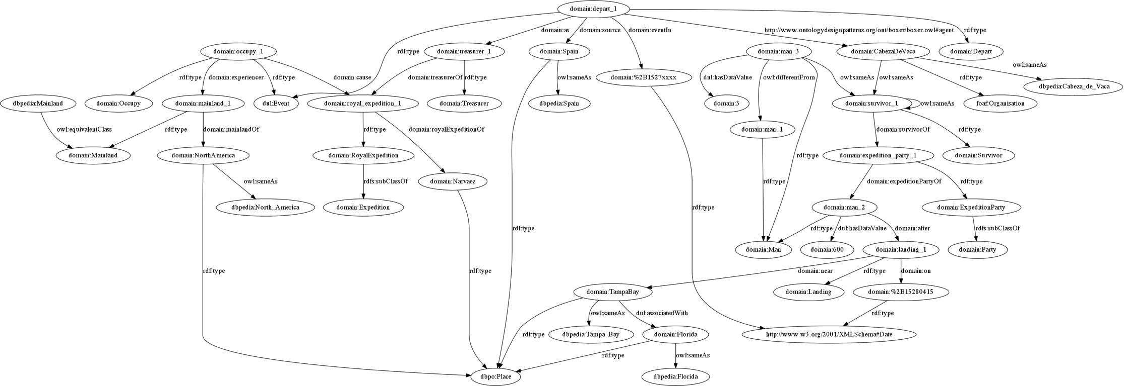
FRED: RDF/OWL graph output
Semantic roles
Custom namespace
Frames/events
Co-reference
Types
Induced types
(sense tagging)
Taxonomy
induction
Resolution and linking
Vocabulary
alignment

Slide 23

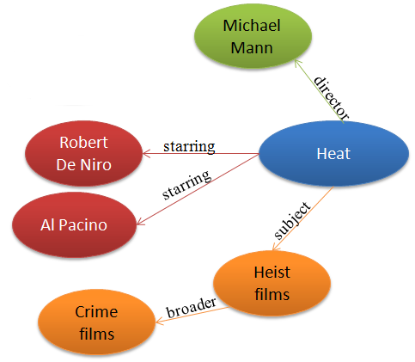

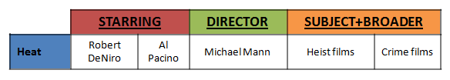
Linked Data as structured information source for items descriptions
Rich items descriptions

Slide 24
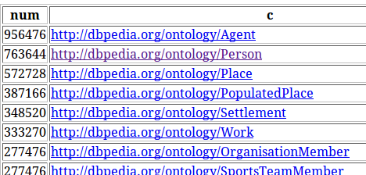
Select the domain(s) of your RS
SELECT count(?i) AS ?num ?c
WHERE {
?i a ?c .
FILTER(regex(?c, "^http://dbpedia.org/ontology")) .
}
ORDER BY DESC(?num)

Slide 25
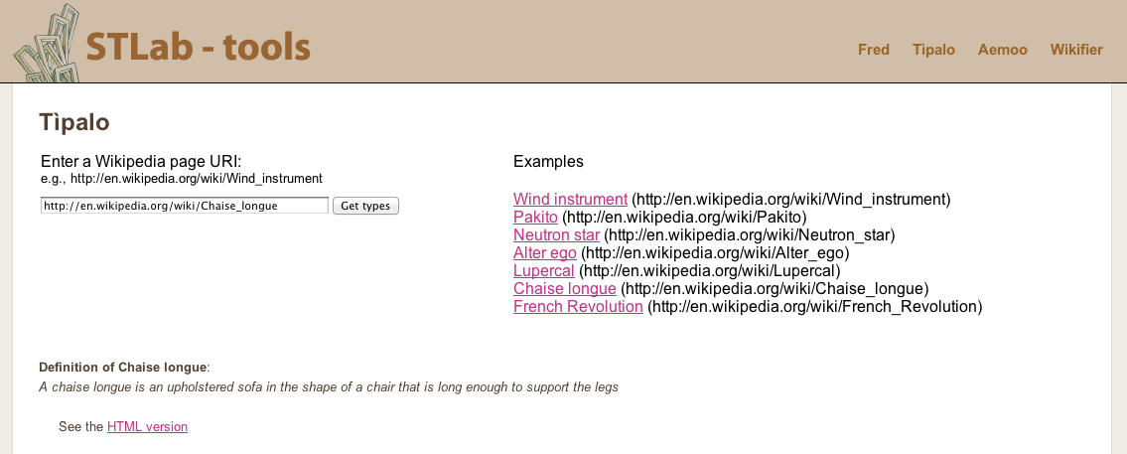
Tìpalo: automatic typing of DBpedia entities
Input: natural language definition of an entity

Slide 26
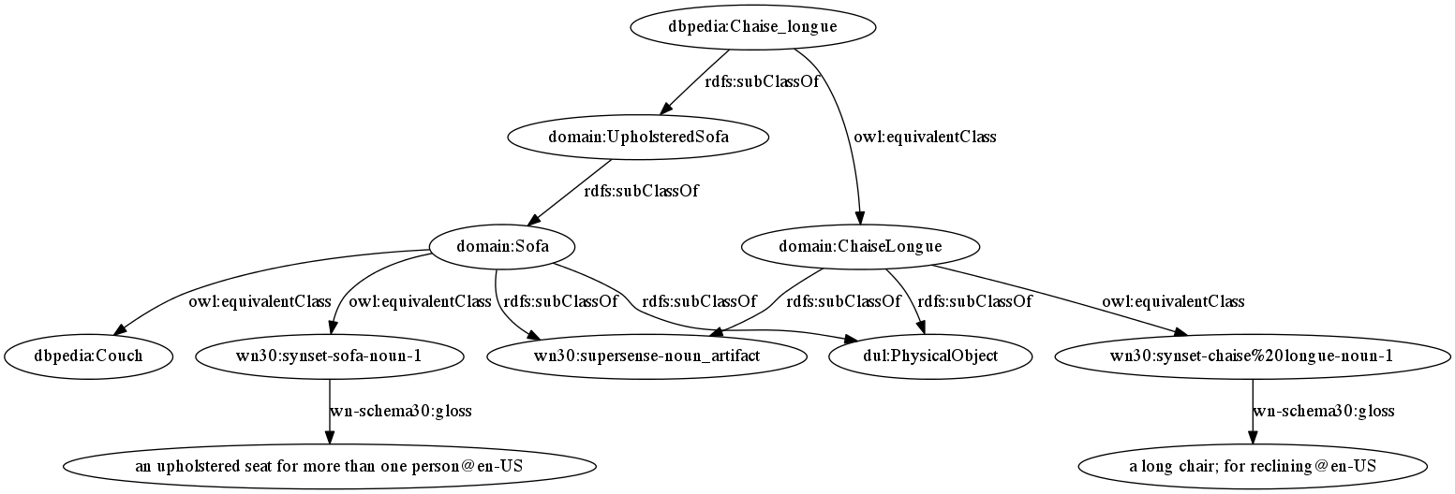
A chaise longue (English /ˌʃeɪz ˈlɔːŋ/;[1] French pronunciation: [ʃɛzlɔ̃ŋɡ(ə)], "long chair") is an upholstered sofa in the shape of a chair that is long enough to support the legs.
http://en.wikipedia.org/wiki/Chaise_longue
DBpedia resource
Extracted type
A chaise longue is an upholstered sofa in the shape of a chair that is long enough to support the legs.
Inferred superclass
Linked resource
Disambiguated sense
Linking to WN supersenses
Disambiguated sense
Linking to DOLCE
Rich taxonomical data!

Slide 27
Select the sub-graph you are interested in
select ?m ?p ?o1
where{
?m ?p ?o1 .
?m dcterms:subject ?o.
dbpedia:The_Matrix dcterms:subject ?o.
?m a dbpedia-owl:Film.
filter(regex(?p,"^http://dbpedia.org/ontology/")).
}
order by ?m

Slide 28
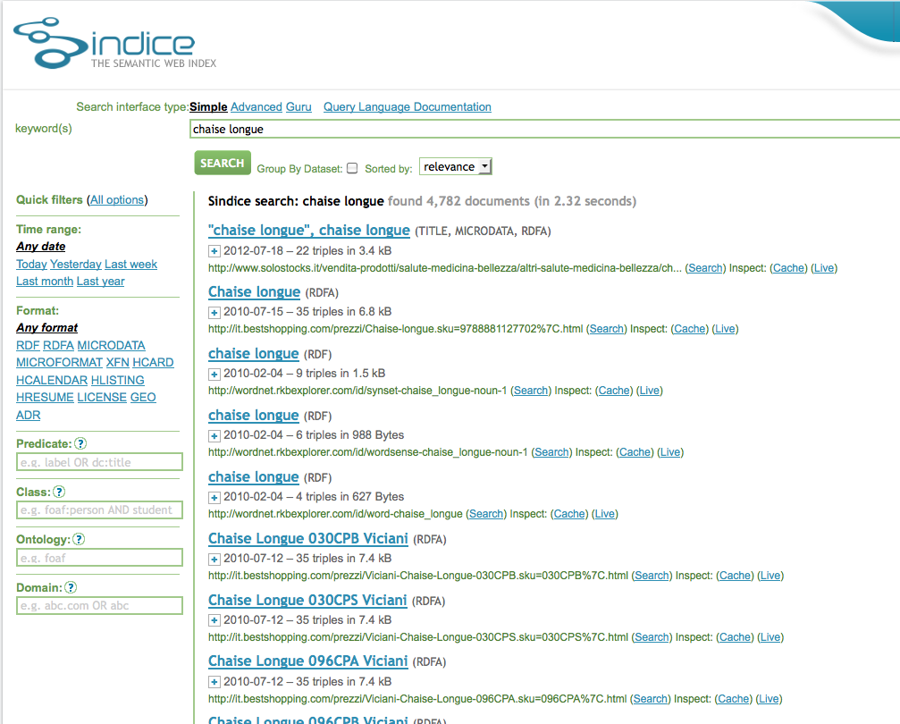
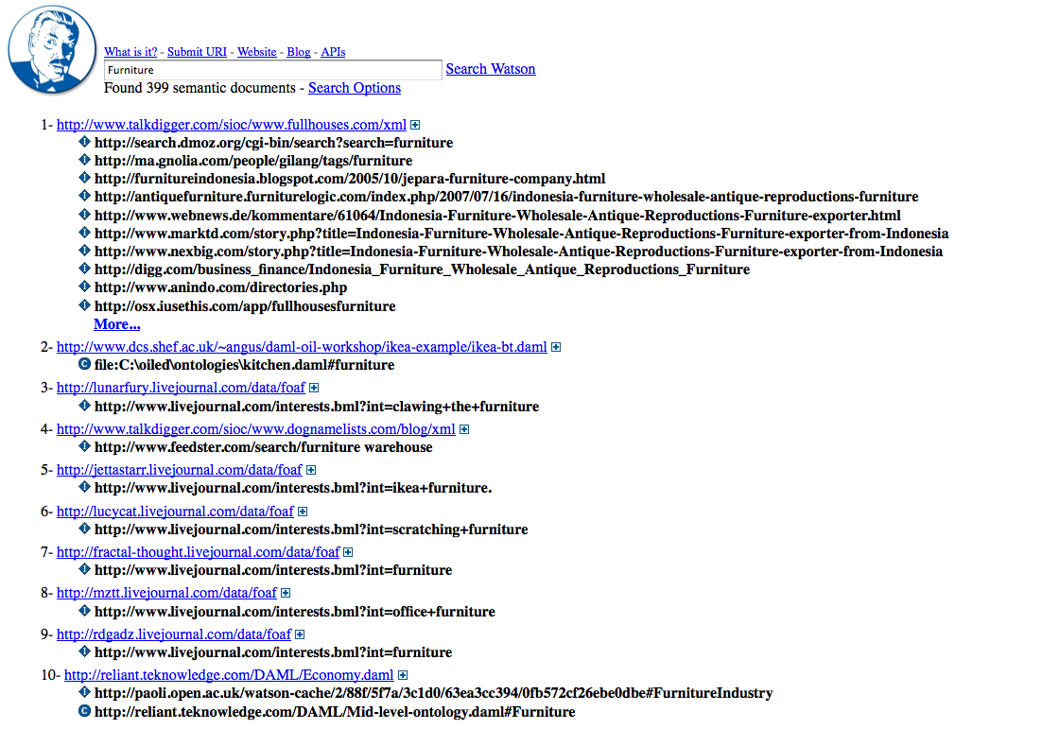
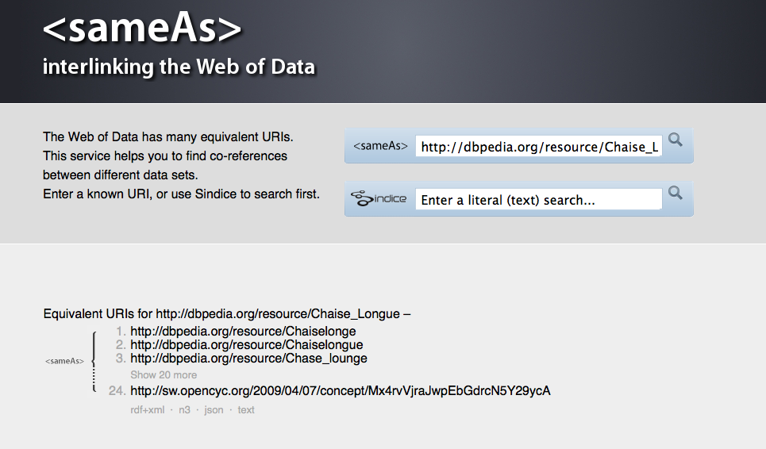
Enriching Annotations with Resources From the Web
Watson: find ontologies on the Semantic Web
for enriching the representation of your data
Sindice: find other entities for enriching
your knowledge base
SameAs.org: find other entities to link to
from your knowledge base

Slide 29
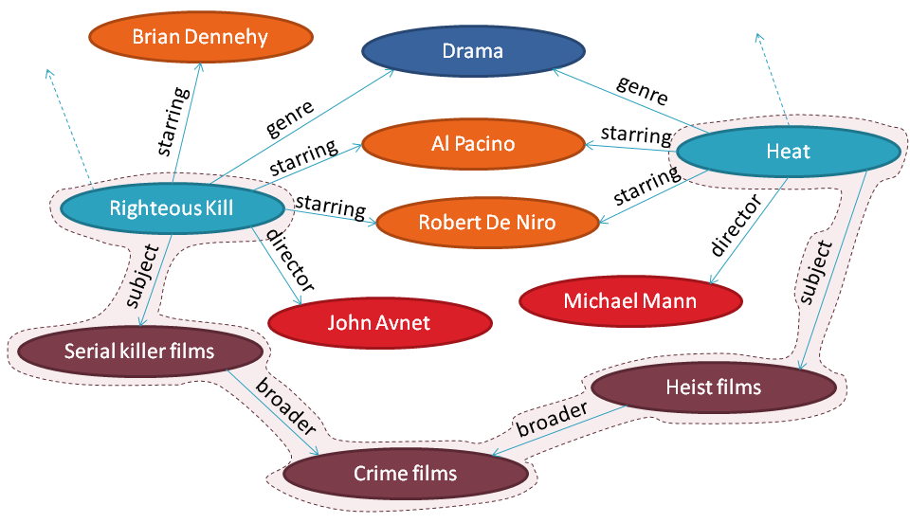
Computing similarity in LOD datasets

Slide 30
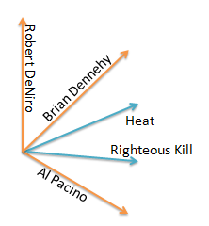
Vector Space Model for LOD
Righteous Kill
Heat
Righteous Kill
starring
Heat
Brian Dennehy
Al Pacino
… …
Robert De Niro
genre
subject/broader
director
starring
Drama
Robert De Niro
Al Pacino
John Avnet
Crime films
Brian Dennehy
Serial killer films
Heist films

Slide 31
Vector Space Model for LOD
STARRING | Al Pacino (v1) | Robert De Niro (v2) | Brian Dennehy (v3)
Righteous Kill (m1) | X | X | X
Heat (m2) | X | X
Righteous Kill
Heat
$w_{AlPacino,Heat}=tf_{AlPacino,Heat} ∗idf_{AlPacino}$
Righteous Kill (x1) | w_{v1,x1} | w_{v2,x1} | w_{v3,x1}
Heat (x2) | w_{v1,x2} | w_{v2,x2} | 0

Slide 32

Vector Space Model for LOD
STARRING | Al Pacino (a1) | Robert De Niro (a2) | Brian Dennehy (a3)
Righteous Kill (x1) | O | O | O
Heat (x2) | O | O
Righteous Kill
Heat
$$tf∈\{0,1\}$$
$w_{AlPacino,Heat}=tf_{AlPacino,Heat} ∗idf_{AlPacino}$
Righteous Kill (m1) | w_{a1,m1} | w_{a2,m1} | w_{a3,m1}
Heat (m2) | w_{a1,m2} | w_{a2,m2} | 0

Slide 33
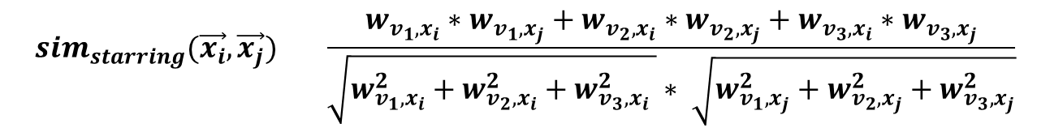




Vector Space Model for LOD
$$sim_{starring}(\vec{x_{i}},\vec{x_{j}}) ={\frac{w_{v_{1},x_{i}}∗w_{v_{1},x_{j}}+w_{v_{2},x_{i}}∗w_{v_{2},x_{j}}+w_{v_{3},x_{i}}∗w_{v_{3},x_{j}}}{\sqrt{w_{v_{1},x_{i}}^{2}+w_{v_{2},x_{i}}^{2}+w_{v_{3},x_{i}}^{2} }∗ \sqrt{w_{v_{1},x_{j}}^{2}+w_{v_{2},x_{j}}^{2}+w_{v_{3},x_{j}}^{2}}}}$$
$$α_{starring}∗sim_{starring}(\vec{x_{i}},\vec{x_{j}})$$
+
$$α_{director}∗sim_{director}(\vec{x_{i}},\vec{x_{j}})$$
+
$$α_{subject}∗sim_{subject}(\vec{x_{i}},\vec{x_{j}})$$
+
… =
$$sim_{starring}(\vec{x_{i}},\vec{x_{j}})$$

Slide 34
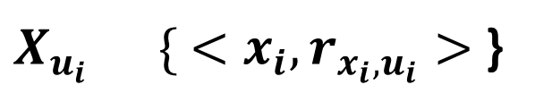
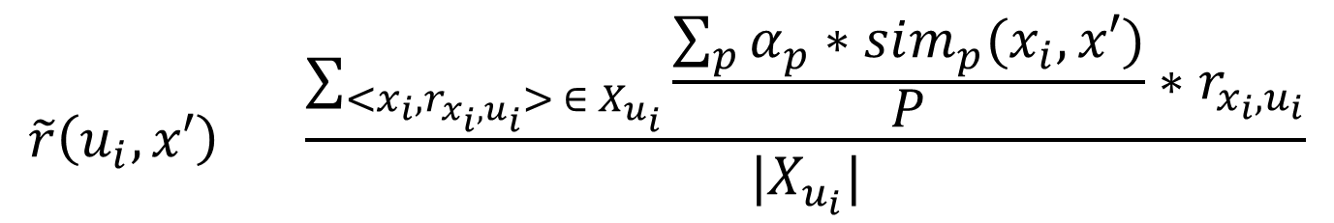
LOD-based CB RS
$X_{u_{i}}=\{ <x_{i}, r_{x_{i},u_{i}}>$ }
Given a user profile defined as:
We can predict the rating using a Nearest Neighbor Classifier wherein the similarity measure is a linear combination of local property similarities
$$\tilde{r}\left(u_{i},x′\right)= \frac{\sum_{<x_{i},r_{x_{i},u_{i}}> ∈ X_{u_{i}}}{\frac{\sum_{p}{α_{p}∗sim_{p}(x_{i},x′)}}{P}∗r_{x_{i},u_{i}}}}{|X_{u_{i}}|}$$
=

Slide 35
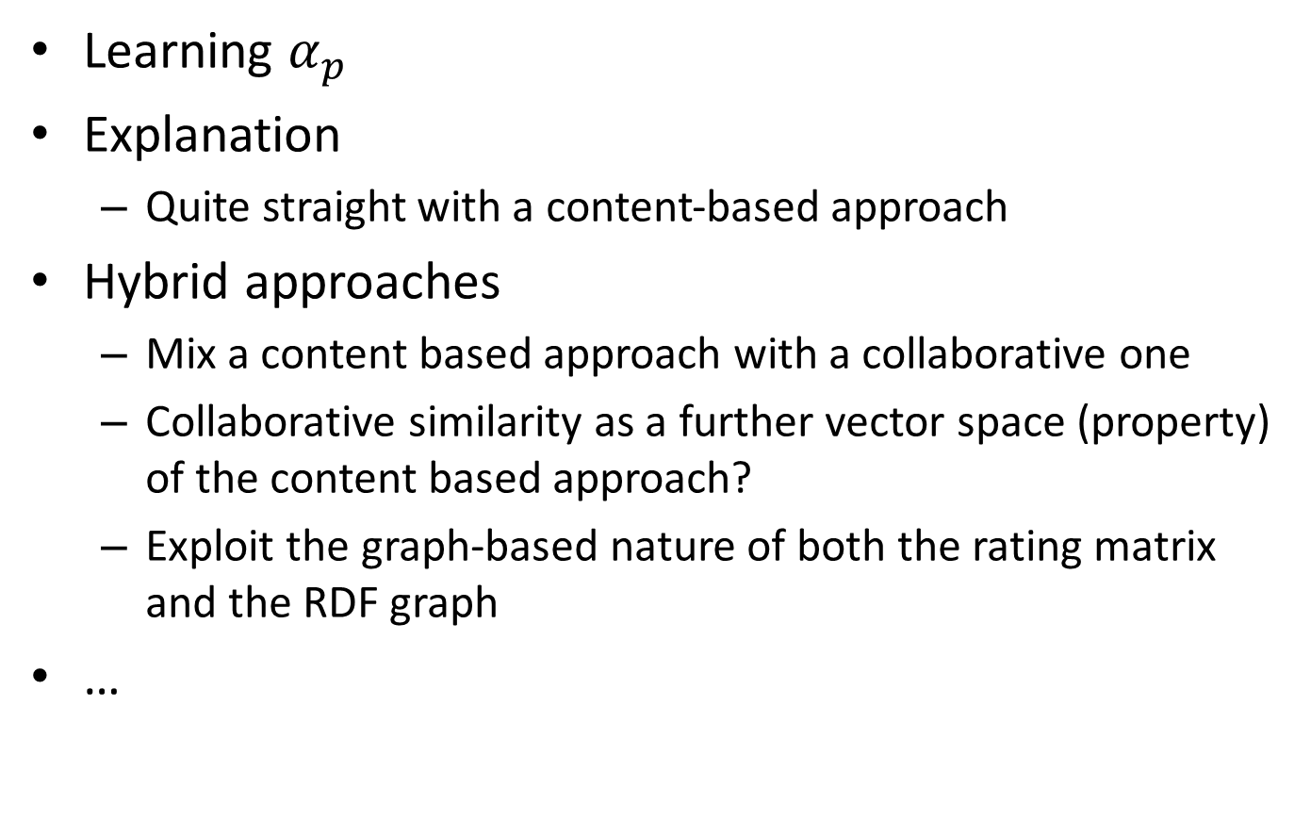
Missing in this presentation (not a complete list)
Learning $α_{p}$
Explanation
Quite straight with a content-based approach
Hybrid approaches
Mix a content based approach with a collaborative one
Collaborative similarity as a further vector space (property) of the content based approach?
Exploit the graph-based nature of both the rating matrix and the RDF graph
…

Slide 36
Thank you!
Many thanks to Vito Claudio Ostuni and Roberto Mirizzi

